Slide 1
FAIR USE NOTICE
The material used in this presentation i.e., pictures/graphs/text, etc. is solely intended for educational/teaching purpose, offered free of cost to the students for use under special circumstances of Online Education due to COVID-19 Lockdown situation and may include copyrighted material - the use of which may not have been specifically authorised by Copyright Owners. Its application constitutes Fair Use of any such copyrighted material as provided in globally accepted law of many countries. The contents of presentations are intended only for the attendees of the class being conducted by the presenter.

Slide 2
CLOUD COMPUTING

Slide 3
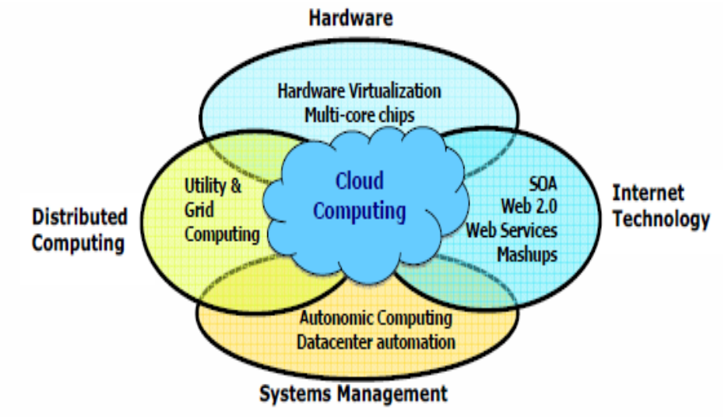
ENABLING TECHNOLOGIES

Slide 4
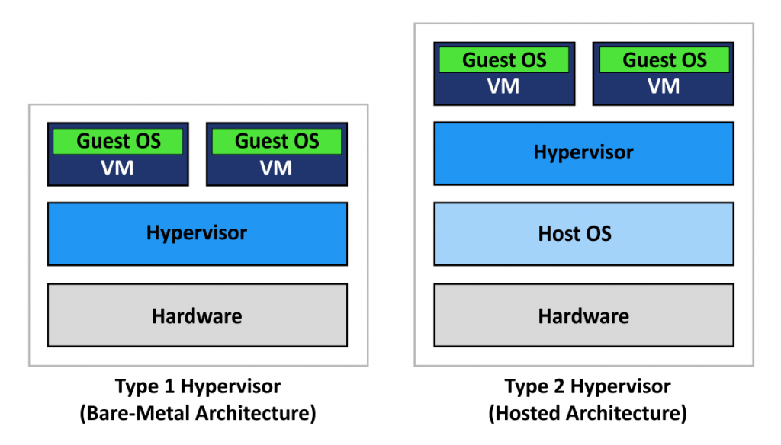
HARDWARE VIRTUALIZATION
Virtualization is the process of creating a software based/virtual version of something, whether that be compute, storage, networking, servers, or applications.
This is enabled by hypervisor.
Benefits -
Cost Saving
Agility & Speed
Portable – Reduced Downtime
Secure with lower latency
Eg. VMware ESXi, Microsoft Hyper-v, KVM
For end user virtualization
Eg. Oracle VirtualBox, VMware Workstation

Slide 5
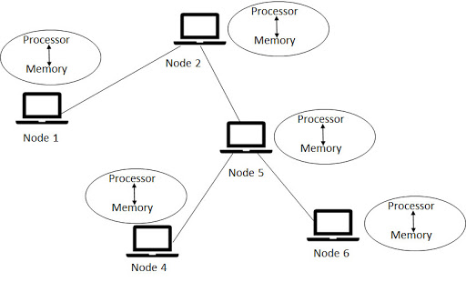
DISTRIBUTED COMPUTING
Distributed computing is computing over distributed autonomous computers that communicate only over a network.
Distributed computing involves processing happening on multiple computers in parallel enabling huge amounts of data to be processed.

Slide 6
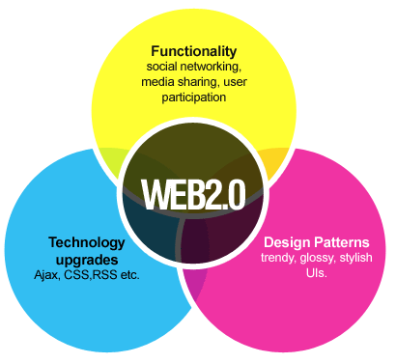
WEB 2.0
Web 2.0 refers to websites that emphasize user-generated content, ease of use, participatory culture and interoperability for end users.
Main concept behind Web 2.0 is to enhances the interconnectivity of Web Application

Slide 7
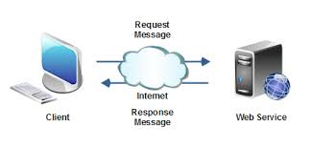
SOA & WEB SERVICES
SOA, or service-oriented architecture, is a software designing style or architecture in which communication protocols are used by the application components to provide services to other components.
A web service is any piece of software that makes itself available over the internet and uses a standardized XML messaging system. XML is used to encode all communications to a web service. For example, a client invokes a web service by sending an XML message, then waits for a corresponding XML response

Slide 8
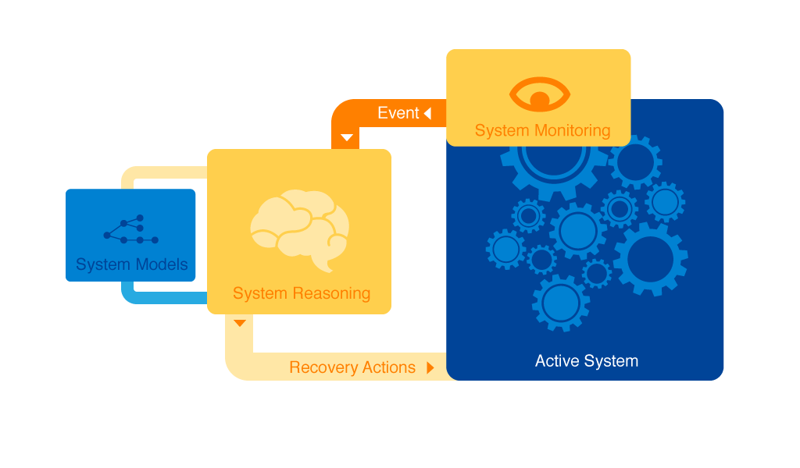
AUTONOMIC COMPUTING
It refers to self-managing characteristics of distributed computing resources, which recognize and understand changes in the system, take appropriate corrective actions completely automatically, with close to zero human intervention.

Slide 9
DATACENTER AUTOMATION
Data center automation is the process by which routine workflows and processes of a data center—scheduling, monitoring, maintenance, application delivery, and so on—are managed and executed without human administration.

